Slide 1
12. NEO Persistable Classes (NPC) Platform 2.1 Overview
NEO Blockchain Quick Start Guide for .NET Developers
Michael Herman
https://github.com/mwherman2000/neo-dotnetquickstart
https://github.com/mwherman2000/neo-csharpcoe
https://github.com/mwherman2000/neo-persistableclasses
neotoronto@outlook.com

Slide 2
Overview
Purpose
An overview of the architecture of the NEO Persistable Classes (NPC) Platform 2.1
Live demonstration of build C#.NPC smart contract with the NPC Compiler 2.1
Goals, Non-Goals and Assumptions
Level of detail: Awareness
Principles
Provide reliable information: timely, accurate, visual, and complete
Use as little time of your time as possible
Drivers
Need in the NEO .NET developer community to have a concise and easy-to-follow documented approach that enables enterprise developers to get up to speed developing NEO smart contracts in as short a time as possible
Tools, Reusable Code, Documentation, Best Practices, Training

Slide 3
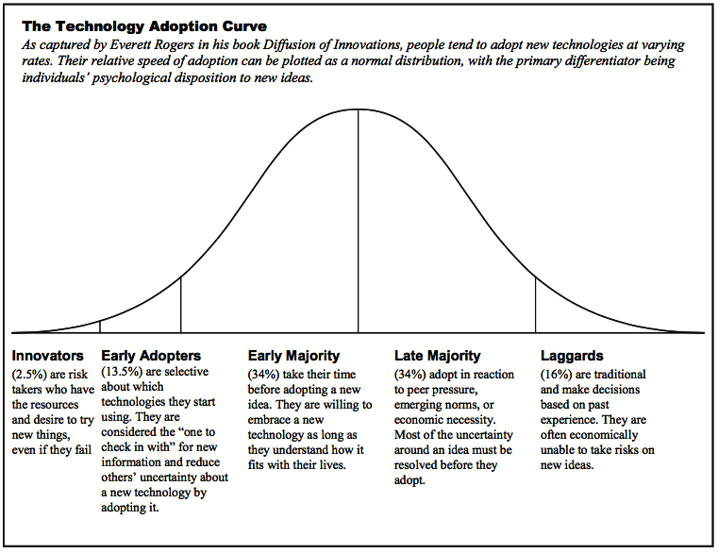
Overview
Target Audience
and
Knowledge Transfer Goals
Wisdom
Understanding
Knowledge
Awareness

Slide 4
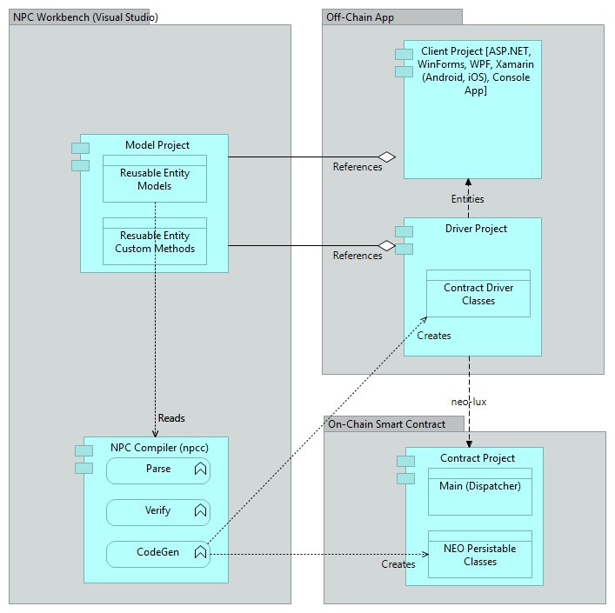













Overview
NEO Persistable Classes (NPC) Platform 2.1 Architecture

Slide 5
Questions?
neotoronto@outlook.com

